Slide 1
CMSC201 Computer Science I for Majors Lecture 06 – While Loops

Slide 2
Last Class We Covered
Algorithms
Program design
Input, process, output
Flowcharts and pseudocode
Syntax and Logic Errors
Decision structure practice

Slide 3
Any Questions from Last Time?

Slide 4
Today’s Objectives
To learn about and use a while loop
To understand the syntax of a while loop
To use a while loop for interactive loops
To learn about infinite loops
(And how to avoid them)
To practice conditionals

Slide 5
Practice: if, elif, and else
if
else
elif
if
elif
elif
else
else
if
elif
if
elif
if
if
elif
else
if
else
if
elif
elif
else
if
if
if
else
if
if
elif

Slide 6
Practice: if, elif, and else
✗
✗
✓
if
else
elif
if
elif
elif
else
else
if
elif
if
elif
✓
if
if
elif
else
✗
if
else
if
elif
elif
else
✓
if
if
if
else
if
✓
if
elif

Slide 7
Practice: if, elif, and else
✗
✗
✓
if
else
elif
if
elif
elif
else
else
if
elif
if
elif
✓
if
if
elif
else
✗
if
else
if
elif
elif
else
✓
if
if
if
else
if
✓
if
elif

Slide 8
Looping

Slide 9
Control Structures
Structures that control how the program “flows” or operates, and in what order
Sequence
Decision Making
Looping
✓
we’ve already seen these
✓
what we’re covering today

Slide 10
Looping
Doing something over and over (and over) again
Used in combination with decision making
If no decision is being made, we just loop forever
This is called an “infinite loop”
What are some real life examples?
Jumping rope
Walking up steps

Slide 11
Looping
We’ll cover this in detail today
It looks something like this…
expression
True
statement
False

Slide 12
Looping
Python has two kinds of loops, and they are used for two different purposes
The while loop
Works for basically everything
The for loop:
Best at iterating over something
Best at counted iterations
what we’re covering today

Slide 13
The while Loop

Slide 14
“while” Loops
while <condition>: <body>
The body is a sequence of one or more statements indented under the heading
As long as the condition is True, the body will run (repeatedly if needed)

Slide 15
How a while Loop Works
The while loop uses a Boolean condition
That evaluates to either True or False
If the condition is True:
Body of while loop is executed
Once that’s over, condition is checked again
If the condition is False:
Body of while loop is skipped

Slide 16
Parts of a while Loop
Here’s some example code… let’s break it down
date = 0
while date < 1 or date > 30:
date = int(input("Enter the day: "))
print("Today is September", date)

Slide 17
Parts of a while Loop
Here’s some example code… let’s break it down
date = 0
while date < 1 or date > 30:
date = int(input("Enter the day: "))
print("Today is September", date)
initialize the variable the while loop will use for its decision
the loop’s Boolean condition (loop runs until this is False)
the body of the loop (must change the value of the loop variable)

Slide 18
Example while Loop
We can use a while loop to count
Count from 1 up to and including 20
num = 1 # we have to initialize num
while num <= 20: # so that we can use it here
print(num)
num = num + 1 # don't forget to update # the loop variable

Slide 19
Example while Loop
Start
num = 1
while
num <= 20
TRUE
Display num
num = num + 1
FALSE
End

Slide 20
Example Counting while Loops
By changing a number of factors, you can change how a counting loop behaves
num = 1 # this controls the start
while num <= 20: # this controls the stop
print(num)
num = num + 1 # this controls the update
How would you count 2, 4, 6, ... 96, 98, 100?
What about from 10 down to 0?

Slide 21
Calculating while Loops
For a while loop that needs to calculate something, you must initialize the relevant variable outside of the loop, before it starts
For example, if calculating the total of 10 user-provided numbers, initialize a “total” variable before the while loop

Slide 22
Totaling while Loop
Here is a completed example:
count = 0
total = 0
while count < 10:
num = int(input("Please enter a number: "))
total += num
count += 1
print("The total is", total)

Slide 23
Infinite Loops and Other Problems

Slide 24
Loop Body Not Being Reached
A while loop’s body may be skipped over entirely
If the Boolean condition is initially False
militaryTime = 1300
while (militaryTime < 1200):
print("Good morning!")
militaryTime = militaryTime + 100

Slide 25
When is the Conditional Checked?
savings = 0
while savings < 1000:
# full-time job pays out
savings += 500
# freelancing job pays out
savings += 150
print("savings is", savings)
What is the value of savings at the end?

Slide 26
When is the Conditional Checked?
savings = 0
while savings < 1000:
# full-time job pays out
savings += 500
# freelancing job pays out
savings += 150
print("savings is", savings)
What is the value of savings at the end?
The value of savings is 1300
Even though the condition was “reached” when we added 500 the second time, the entire loop must run before the conditional is checked again

Slide 27
Infinite Loops
An infinite loop is a loop that will run forever
The conditional the loop is based on always evaluates to True, and never to False
Why might this happen?
The loop variable is not updated
The loop variable is updated wrong
The loop conditional uses the wrong variable
The loop conditional checks the wrong thing

Slide 28
Infinite Loop Example #1
Why doesn’t this loop end? What will fix it?
age = int(input("How old are you? "))
while age < 18: # can't vote until 18
print("You can't vote at age", age)
print("Now you can vote! Yay!")

Slide 29
Infinite Loop Example #1
Why doesn’t this loop end? What will fix it?
age = int(input("How old are you? "))
while age < 18: # can't vote until 18
print("You can't vote at age", age)
print("Now you can vote! Yay!")
the loop variable (age) never changes, so the condition will never evaluate to False

Slide 30
Infinite Loop Example #2
Why doesn’t this loop end? What will fix it?
while True:
# ask user for name
name = input("What is your name? ")
print("Hello", name, "!")

Slide 31
Infinite Loop Example #2
Why doesn’t this loop end? What will fix it?
while True:
# ask user for name
name = input("What is your name? ")
print("Hello", name, "!")
True will never evaluate to False, so the loop will never exit
Don’t ever do this! It’s sloppy programming, and it’s not allowed in 201.

Slide 32
Infinite Loop Example #3
Why doesn’t this loop end? What will fix it?
cookiesLeft = 50
while cookiesLeft > 0:
# eat a cookie
cookiesLeft = cookiesLeft + 1
print("No more cookies!")

Slide 33
Infinite Loop Example #3
Why doesn’t this loop end? What will fix it?
cookiesLeft = 50
while cookiesLeft > 0:
# eat a cookie
cookiesLeft = cookiesLeft + 1
print("No more cookies!")
the loop body is INCREASING the number of cookies, so we’ll never reach zero!

Slide 34
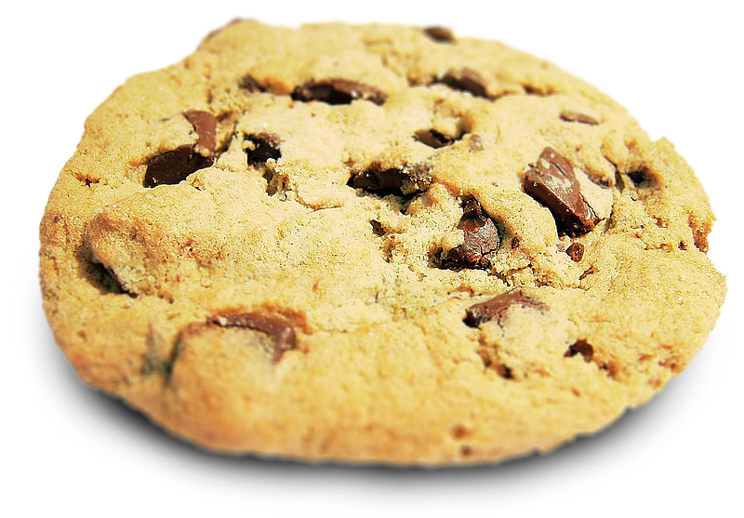
Infinite Loop Example #3
Why doesn’t this loop end? What will fix it?
cookiesLeft = 50
while cookiesLeft > 0:
# eat a cookie
cookiesLeft = cookiesLeft + 1
print("No more cookies!")
the loop body is INCREASING the number of cookies, so we’ll never reach zero!

Slide 35
Infinite Loop Example #4
Why doesn’t this loop end? What will fix it?
countdown = 10
print("Countdown begin...")
while countdown > 0:
print(countdown, "...")
print("Blastoff!")

Slide 36
Infinite Loop Example #4
Why doesn’t this loop end? What will fix it?
countdown = 10
print("Countdown begin...")
while countdown > 0:
print(countdown, "...")
print("Blastoff!")
the countdown variable is not being decremented, so it will never go below zero

Slide 37
Infinite Loop Example #5
Why doesn’t this loop end? What will fix it?
grade = ""
name = ""
while name != "Hrabowski":
# get the user's grade
grade = input("What is your grade? ")
print("You passed!")

Slide 38
Infinite Loop Example #5
Why doesn’t this loop end? What will fix it?
grade = ""
name = ""
while name != "Hrabowski":
# get the user's grade
grade = input("What is your grade? ")
print("You passed!")
the loop conditional is checking the wrong variable! we also never change the name, so this will never end

Slide 39
Ending an Infinite Loop
If you run a Python program that contains an infinite loop, it may seem like you’ve lost control of the terminal!
To regain control, simply type CTRL+C to interrupt the infinite loop
KeyboardInterrupt will be displayed, and you’ll regain control

Slide 40
Practice with Decisions

Slide 41
Loop Example #5 – Fixing It
Let’s update this to ask for the user’s grade
An “A” or a “B” means that they passed
grade = ""
while ...what goes here?
# get the user's grade
grade = input("What is your grade? ")
print("You passed!")

Slide 42
Loop Example #5 – Truth Table
Let’s evaluate this expression
grade != "A" or grade != "B"
grade | grade != "A" | grade != "B" | or
"A" | False | True | True
"B" | True | False | True
"C" | True | True | True

Slide 43
Loop Example #5 – Truth Table
Let’s evaluate this expression
grade != "A" or grade != "B"
This does not give us the answer we want
This just loops forever and ever (infinitely)
grade | grade != "A" | grade != "B" | or
"A" | False | True | True
"B" | True | False | True
"C" | True | True | True

Slide 44
Loop Example #5 – Truth Table
Let’s try it with an and instead of an or
grade != "A" and grade != "B"
grade | grade != "A" | grade != "B" | and
"A" | False | True | False
"B" | True | False | False
"C" | True | True | True

Slide 45
Loop Example #5 – Truth Table
Let’s try it with an and instead of an or
grade != "A" and grade != "B"
Now our program will behave how we want
You have to think carefully about conditionals!
grade | grade != "A" | grade != "B" | and
"A" | False | True | False
"B" | True | False | False
"C" | True | True | True

Slide 46
Loop Example #5 – Completed
Let’s update this to ask for the user’s grade
An “A” or a “B” means that they passed
grade = ""
while grade != "A" and grade != "B":
# get the user's grade
grade = input("What is your grade? ")
print("You passed!")

Slide 47
Interactive while Loops

Slide 48
When to Use while Loops
while loops are very helpful when you want to get input from the user that meets certain specific conditions
Positive number
A non-empty string
A number within a certain range

Slide 49
Example while Loop
We can use a while loop to get correct input from the user by re-prompting them
num = 0
# so that we can use it here
while num <= 0:
num = int(input("Enter a positive number: "))
# while loop exits because num is positive
print("Thank you. The number you chose is:", num)

Slide 50
Updated Exercise: Nail Polish
Update your nail polish “guessing game” to keep re-prompting the user until they guess the right number of bottles
At each step, tell them whether their guess was high or low
Exit the loop when they guess correctly

Slide 51
Daily Command Line Shortcut
TAB
In the command line, hitting TAB will auto-complete up to the point of uniqueness
For example, typing “emacs h” and hitting TAB may auto-complete to “emacs hw1_part”
up arrow
Brings back your previous command in the terminal
Hit again to go further back

Slide 52
Announcements
HW 1 is out on Blackboard now
Must complete the Syllabus and Course Website Quiz to see it
Due by Friday (February 15th) at 8:59:59 PM
HW 2 will be out on Blackboard Saturday
Complete the Academic Integrity Quiz to see it
Due by Friday (February 22rd) at 8:59:59 PM

Slide 53
Image Sources
Infinity symbol:
https://commons.wikimedia.org/wiki/File:Flat_UI_-_infinity.png
Chocolate chip cookie (adapted from):
https://en.wikipedia.org/wiki/File:Choco_chip_cookie.png
Nail polish (adapted from):
https://pixabay.com/p-870857/

